Slide 1

GEN AI SQL-ASSISTANT

Slide 2

Team Introduction
Team Member 1 [Individual team member’s photo]
Name: Srivatsava Title: Developer
Team Member 2 [Individual team member’s photo]
Name: Shubham. Title: Developer.
Team Member 3 [Individual team member’s photo]
Name: Sai Abhilash. Title: Developer.
Team Member 4 [Individual team member’s photo]
Name: Samar. Title: Developer.
Notes:
Introduce the members of your team with a photo and brief introduction of their names and titles. This helps establish credibility and helps the audience connect with your team.

Slide 3

Problem Statement
To develop an SQL Assistant powered by Generative AI that enables non-technical users to generate complex SQL queries using natural language, allowing them to focus on data analysis rather than query writing?
To provide real-time insights from databases, optimize existing queries, and troubleshoot issues efficiently to reduce the time spent on maintenance tasks?
Notes:
Use this slide to clearly define the problem you are trying to solve, who it affects, and what the negative impact is. This will help your audience understand why your solution is necessary and relevant.

Slide 4

Idea and Solution
Problem Identification
This tool is designed to assist users—especially those who may be new to SQL or unfamiliar with a specific database schema—by allowing them to formulate complex queries using simple, conversational prompts.
Solution Description
The SQL Assistant powered by Generative AI (GenAI) integrated with Apache Kafka aims to revolutionize how users interact with SQL databases by enabling real-time query generation, optimization, and debugging through natural language processing.
This also helps to identify the records which are invalid providing data quality checks.
Enhances to create table, if its not created, based on the data provided in the source.
Notes:
Explain your idea and how it solves the problem you have identified. This slide should be clear and concise, describing your solution in a way that is easy for the audience to understand.

Slide 5
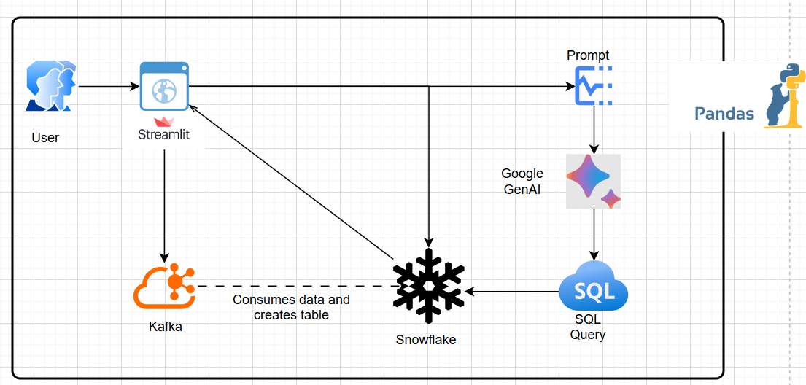
Architecture/Tech Details
Technology
Our solution is built using
Pandas
StreamLit
Kafka
Snowflake
Google Gen AI
Notes:
Explain the technical details of your solution. This slide should describe the architecture of your product or service, the technology used, and how it all works together to deliver the solution.

Slide 6

Business Impact
Enhanced Accessibility
Increased Productivity and Reduce costs
Real-Time Insight
Error Reduction
Improved Query Optimization
Interactive Learning Tool
Scalability
Notes:
Our solution will have a significant impact on the business. By increasing revenue, reducing costs, and improving customer satisfaction, we expect to see a positive ROI within the first year of implementation.

Slide 7
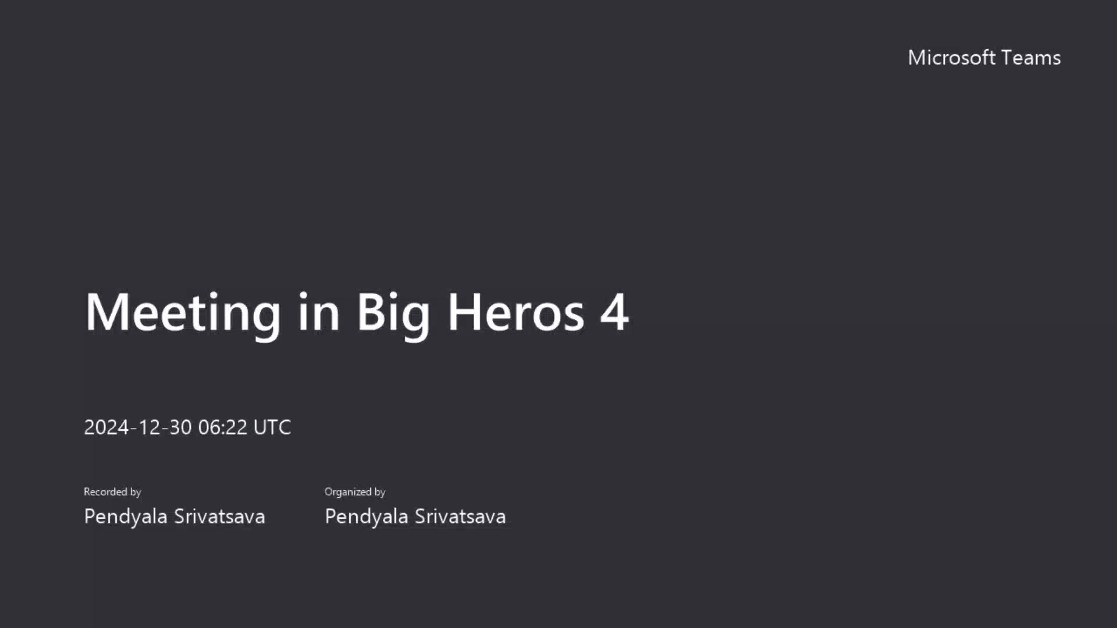

Demo
Demonstrate your product or service in action to show the audience how it solves the problem identified.
Notes:
Demonstrate your solution in action. This slide can include a video or screenshots of your product or service in use, and should show the audience how your solution solves the problem you have identified.

Slide 8

Q&A
Notes:
End your presentation with a Q&A session. This slide should invite the audience to ask questions about your solution, and should provide a contact email or phone number for follow-up questions.

